Slide 1
Steel Faults
AWS Full Stack Project
AI Camp
Amita Panesar

Slide 2
Problem Statement
The industry that I work in specialises in engineering and component manufacturing.
Effective Fault Diagnosis (FD) has a major importance to reduce production cost and enhance quality.
From quality-data available what can be done
To improve process and product quality?

Slide 3
Project Objective
Develop a model to predict faults for the provided measurements of the Steel plate samples in AWS tool.
To classify steel plates fault into 7 different fault classifications
The goal is to train machine learning for automatic pattern recognition.
Evaluate Metrics for Judging the models used

Slide 4
Dataset: Steel Faults
This dataset comes from research by Semeion, Research Centre of Sciences of Communication.
Downloaded from the UCI Machine Learning Repository.
All numerical values
1941 Sample size

Slide 5
Dataset Features
0:27 Independent variables
7 Multi-classification attributes as the labels
Data set here
steel_faults.csv

Slide 6
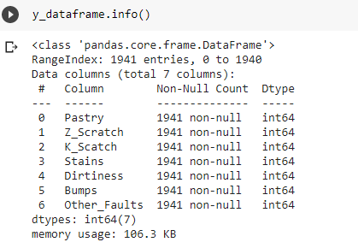
Classification labels snapshot

Slide 7
Feature Engineering
To make the Steel Faults dataset acceptable in Amazon Sagemaker I needed to in Python:
Encode the target labelling from 7 columns into 1.
Move the target feature to the front
Remove the Header
Train sample data as output (Steel_faults_train)
Test sample for validation as output (Steel_faults_test)

Slide 8
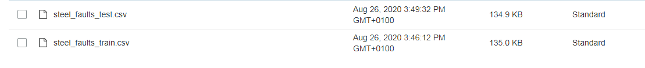
Define the path to store data s3- aws

Slide 9
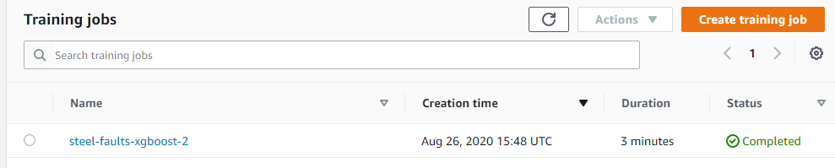
SUBMIT THE TRAINING JOB using XGBoost mODEL

Slide 10
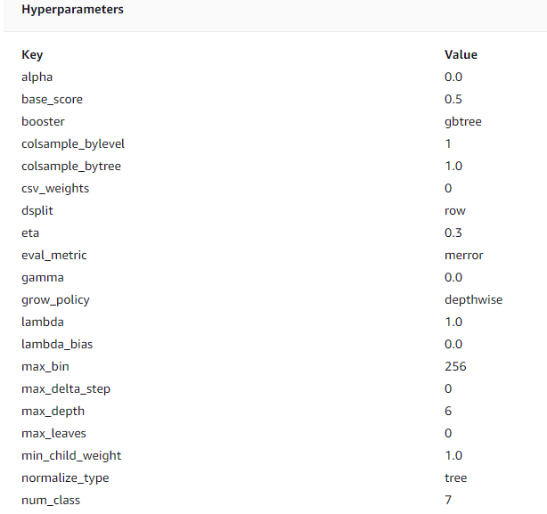
Define the Hyperparameters

Slide 11
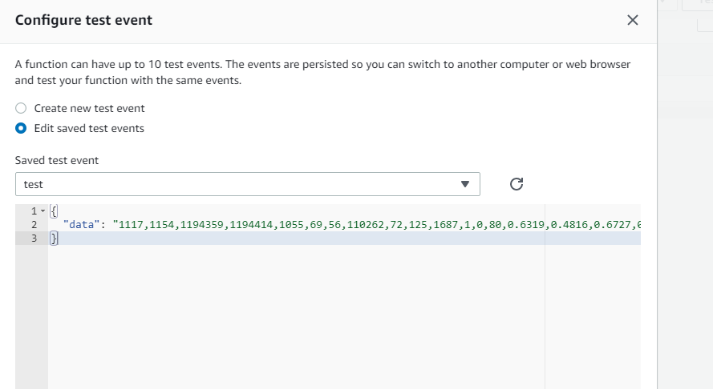
Use Lamda to test sample

Slide 12
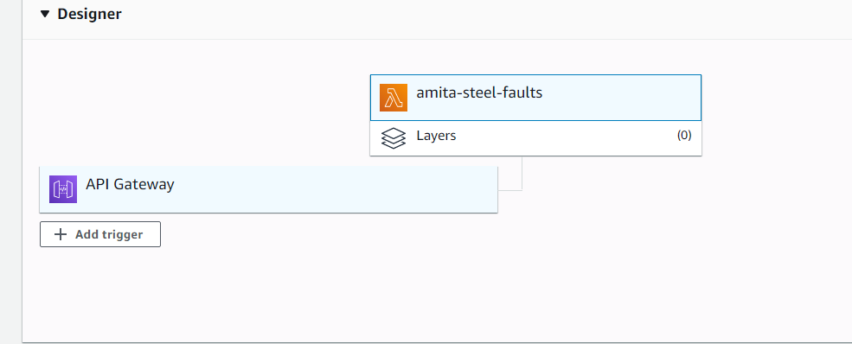
Create API

Slide 13
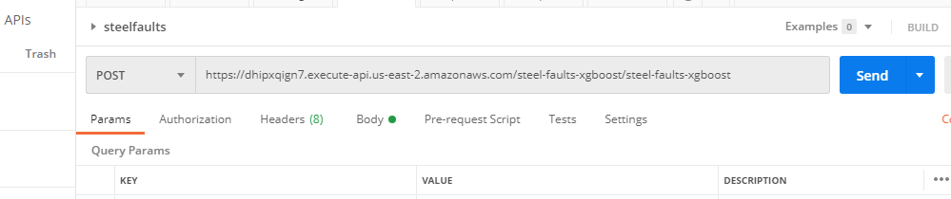
Trigger the API using POSTMAN

Slide 14
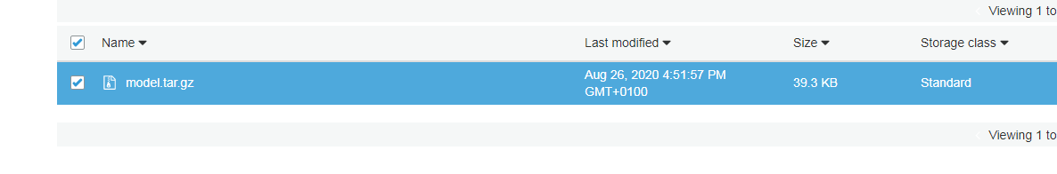
NEXT CHALLENGE IS TO EVALUATE MODEL

